Slide 1
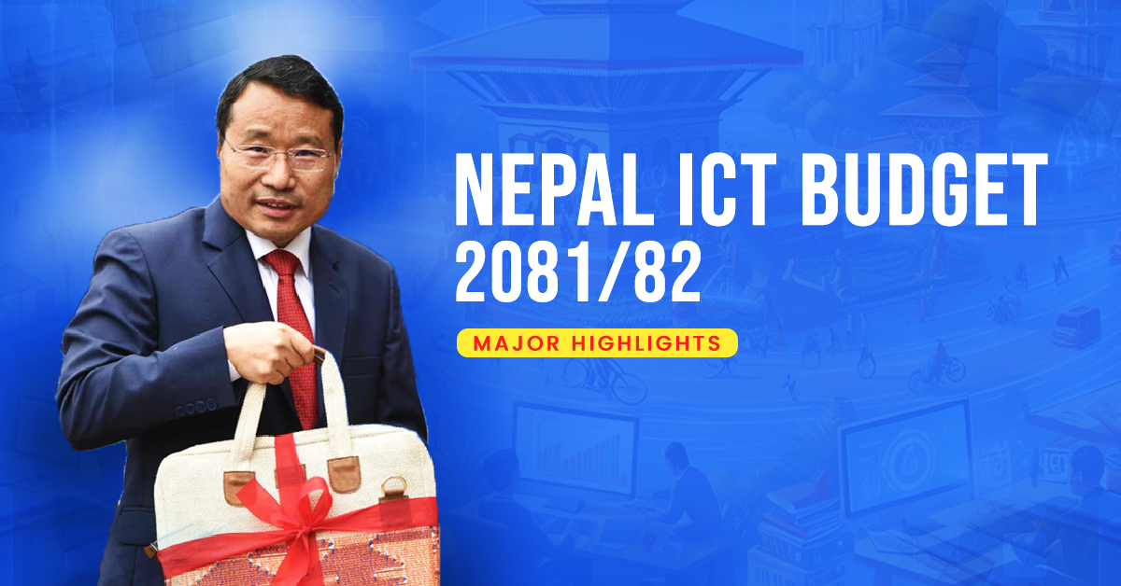

Slide 2
Nepal Government’s 2081/82 ICT Budget:
HIGHLIGHTS
The government has announced a total budget of Rs. 1.86 trillion for 2081/82.
The budget will allocate Rs. 73.50 billion to the Ministry of Communication and Information Technology.
The government targets Rs. 3 trillion worth of exports from the IT sector in the upcoming 10 years.

Slide 3
Finance Minister Mr. Barshaman Pun announced the initiation of the Information Technology decade by unveiling the fiscal budget 2081/82 on Tuesday, May 28.
In the budget speech, he outlined several plans and proposals that aim to position Nepal as an Information Technology hub and a major player in driving the country’s economy.
Major Plan and Policy Announcements For the ICT Sector
The government aims to export Rs. 3 trillion worth of ICT services in the upcoming 10 years. According to the IIDS report, in 2022, Nepali ICT professionals exported services worth Rs. 67 billion. With the rapidly growing ICT industry, the government also aims to generate 500,000 direct jobs and 1,000,000 indirect jobs.
During the budget presentation for the upcoming financial year, Minister Pun announced that the government will provide educational loans for students studying engineering and information technology subjects. These loans will be offered at concessional rates to support bachelor’s and master’s level education.

Slide 4
To move closer to a digitally integrated system, a national ID will now be compulsorily required for obtaining a driver’s license, bluebook, PAN card, and opening a bank account. According to the government, the national ID card will be linked with citizenship, social security, personal incident registration, and permanent account number (PAN) of the individual.
Minister Pun also disclosed plans to leverage existing government and private complexes in Kathmandu Valley and Butwal to establish IT parks with internet and electricity facilities. The purpose of these parks will be to provide free space for IT companies to operate ‘workstations’ for a duration of up to three years.
Additionally, he mentioned plans to build numerous structures in Charkhaal, Dillibazar, and Kathmandu, to establish a state-of-the-art information technology hub through public-private partnership.

Slide 5
Other Announcements:
Finance Minister Barshaman Pun announced further important plans and policies that will benefit the country’s Information technology sector. They have been written below.
Prioritizing domestically made software solutions.
Develop standards for data centers to be operated by the policy sector while upgrading existing government data centers.
Making arrangements for the development, regulation, and promotion of artificial intelligence.
Allocating Rs. 170 million to establish a knowledge park at Khumaltar in Lalitpur.
Revision of the Digital Nepal Framework Act. Institutional arrangements will be made for its implementation and regulation. A total of Rs. 690 million has been allocated for the project.
Regulation of advertisement through digital platforms in social media.
Establish incubation centers in all seven provinces to transform innovative ideas into enterprises.
Introduce an online system to facilitate applying for e-visas.
Further expansion of digital and mobile banking services in remote and rural areas.
Ease of access to ICT services to underserved groups, women, and regions.

